Slide 1

Exploratory Data Analysis on Amazon Fine Food Reviews
Data Mining Project
Student : Eman Hrustemović
Professors : Adnan Dželilhodžić, Amela Vatreš Mudželet

Slide 2

INTRODUCTION
Importance of Online Reviews
Amazon's Role
Challenges
Project Focus
Objectives

Slide 3
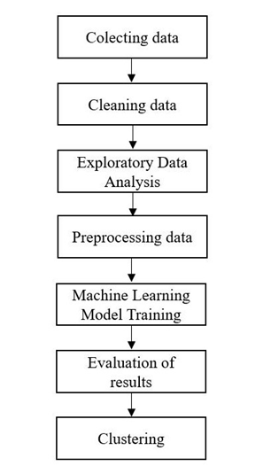
METHODOLOGY STEPS

Slide 4
LITERATURE REVIEW
Data Mining, NLP and Machine Learning in Exploratory Data Analysis (EDA) of the Amazon food reviews dataset.
Graphical representation, Plots, kNN ,Logistic Regression, Naive Bayes, Decision Trees and Clustering.
Research Opportunities:
•Exploratory Data Analysis ( EDA)
•Creating dataset classification
Making predictions using algorithms based on given information.

Slide 5
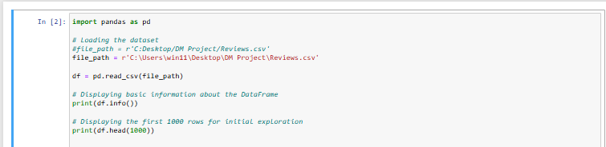
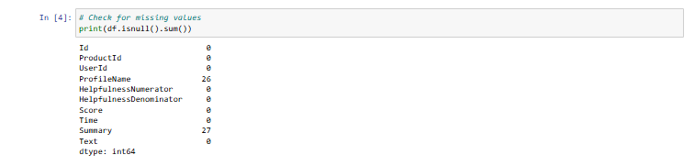
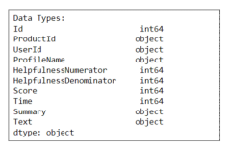
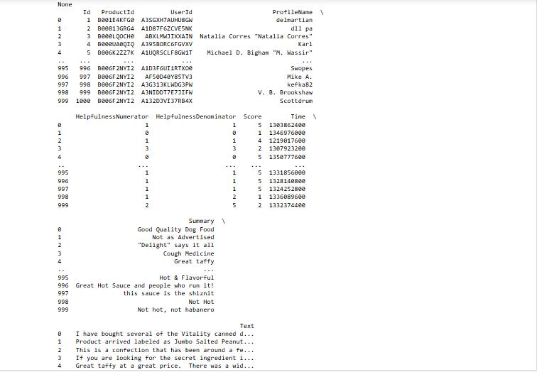
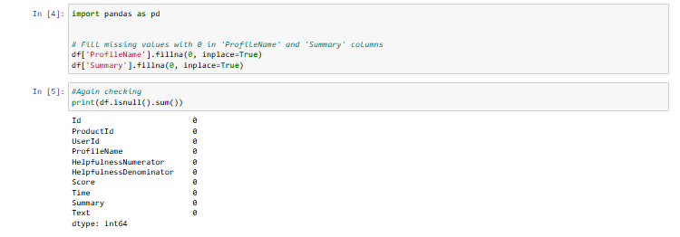
DATASET OVERVIEW
Basic informations about dataset
2. Data Integrity

Slide 6
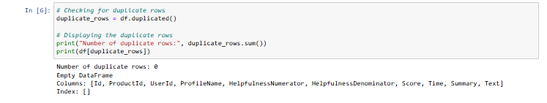
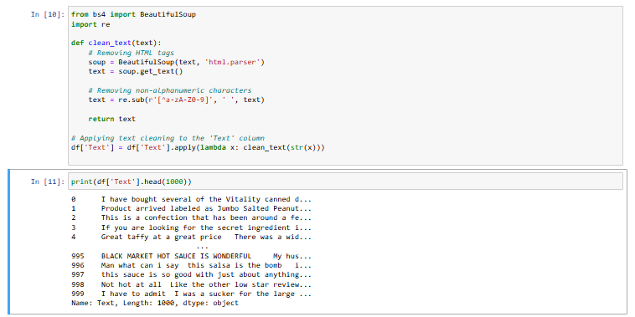
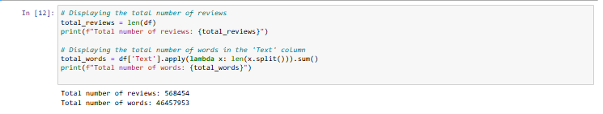
3. Checking duplicates
4. Cleaning
5. Info after performing cleaning

Slide 7
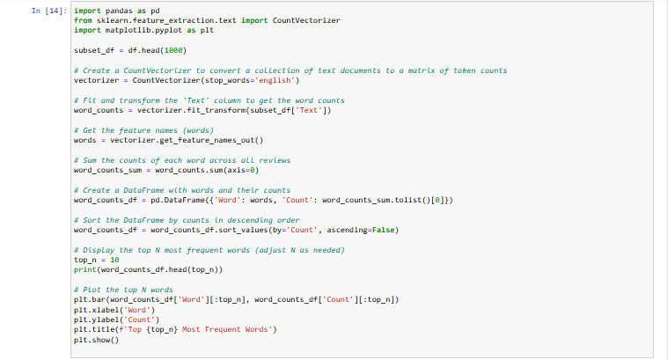
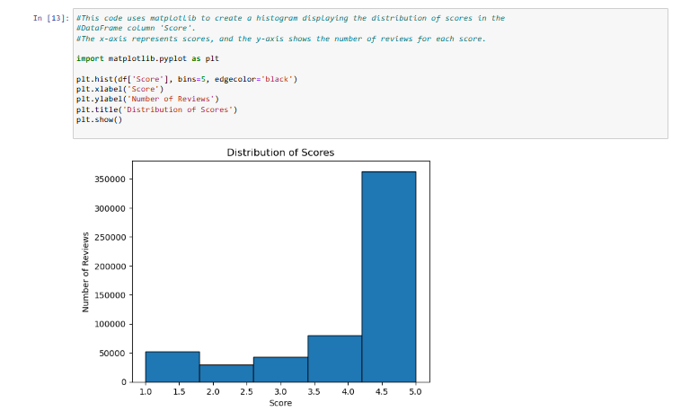
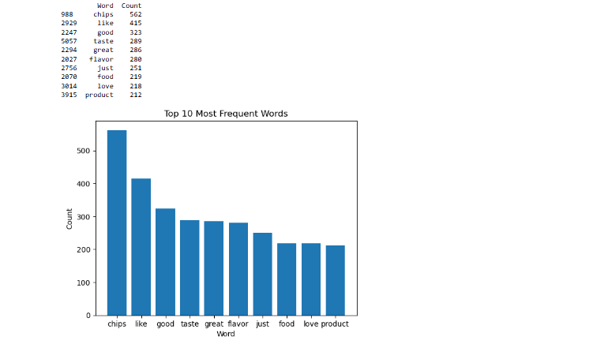
Graphical representation and Plots
Distribution of Scores
Most Frequent Words ( TOP 10)

Slide 8
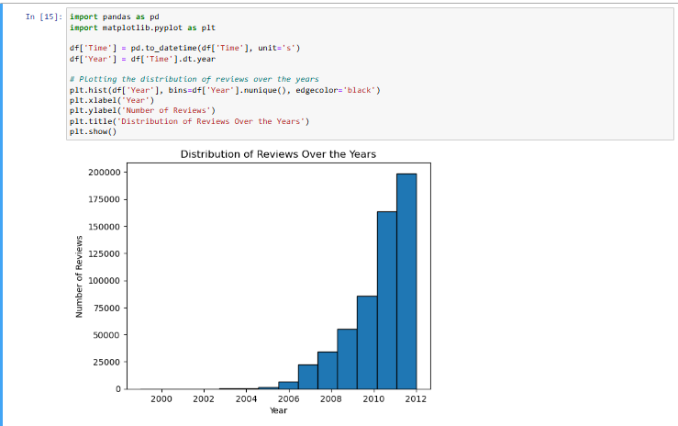
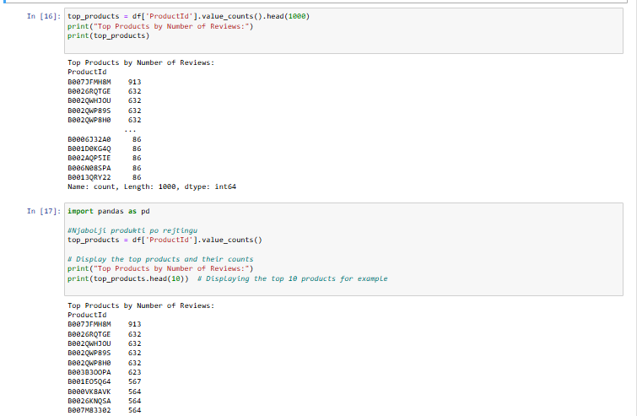
Top products
Distribution of Rewiews Over the Years

Slide 9
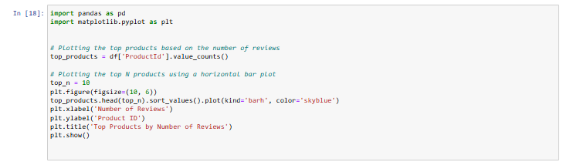
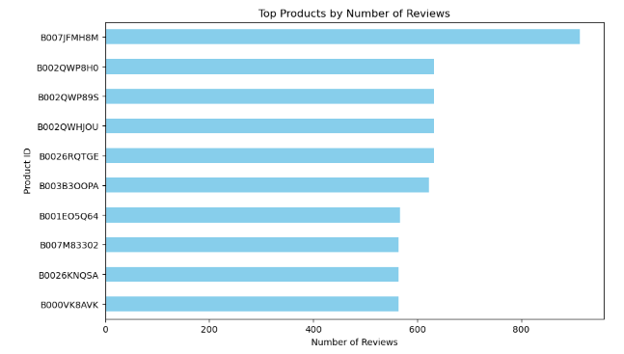
Top 10 products by number of reviews

Slide 10
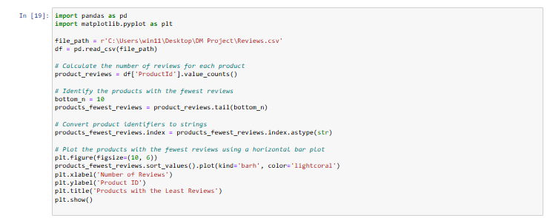
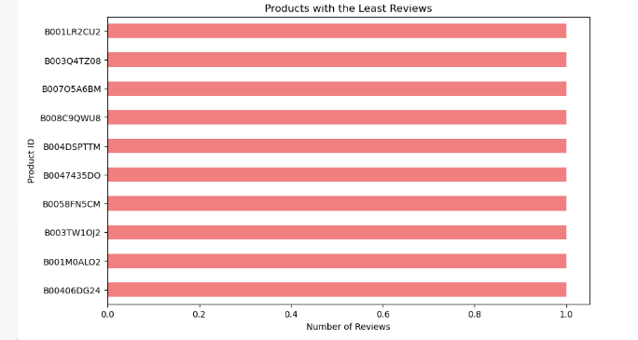
Top 10 products with least reviews

Slide 11
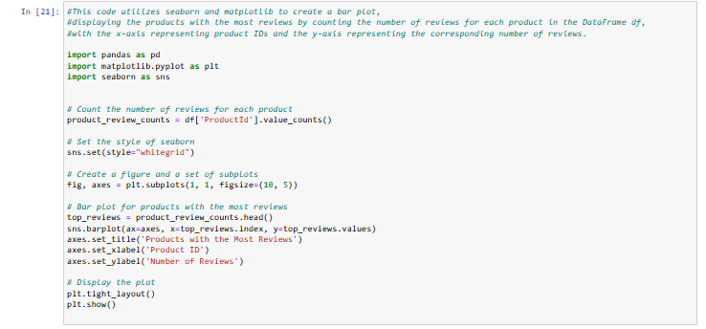
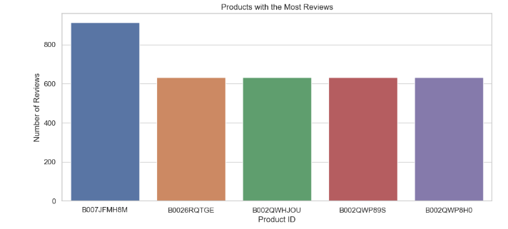
Products with most reviews ( by ProductID)

Slide 12
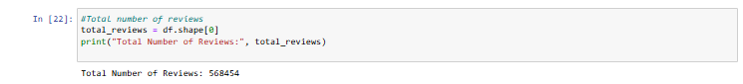
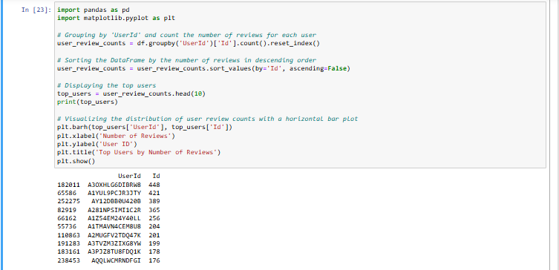
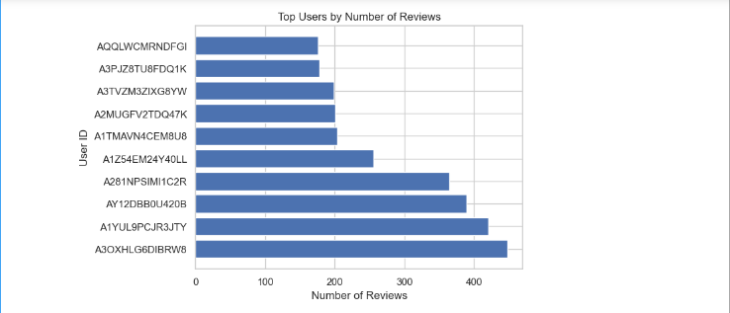
Calculating total number of rewievs
2.Top 10 Users by number of rewievs

Slide 13
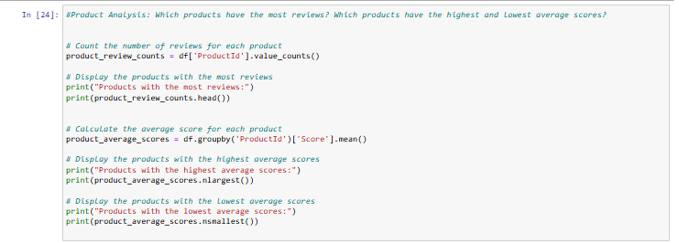
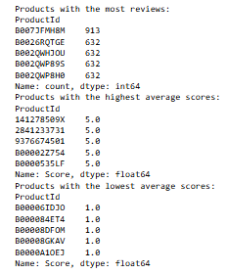
PRODUCT ANALYSIS
Insight into reviews

Slide 14
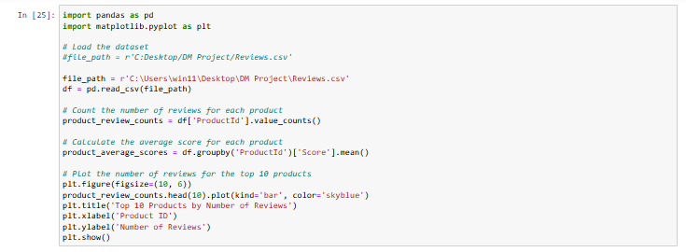
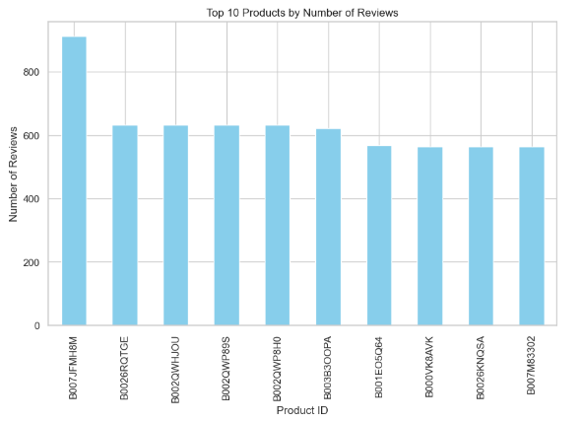

Slide 15
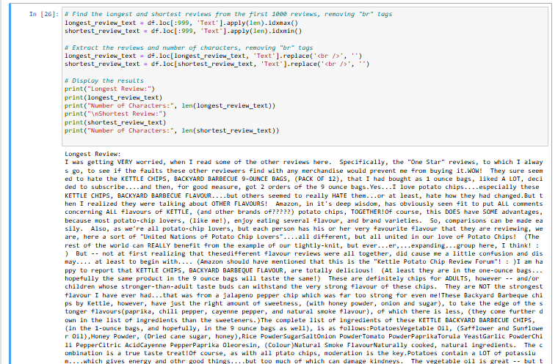
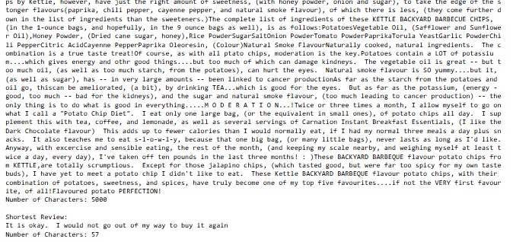
Longest and shortest rewiev after removing <br> in first 1000 rows

Slide 16
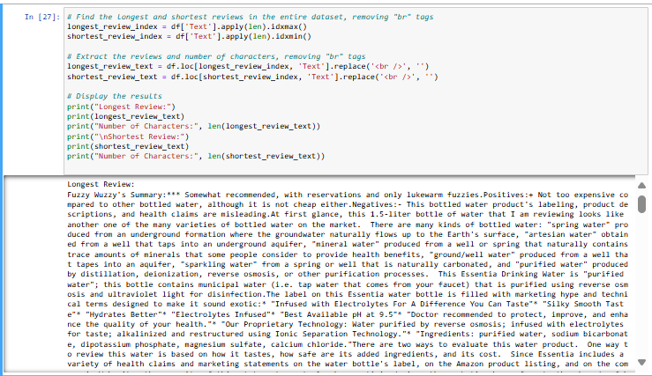
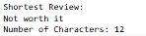
Longest and shortest rewiev after removing <br> in entire dataset

Slide 17
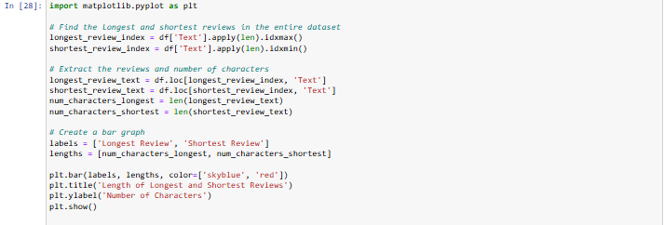
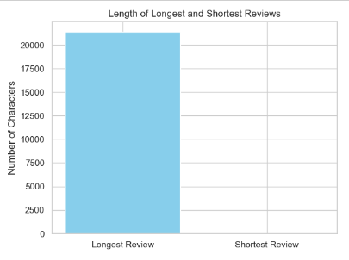
Length of longest and shortest reviews (before cleaning)

Slide 18
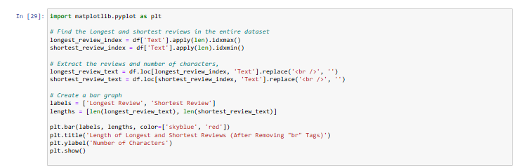
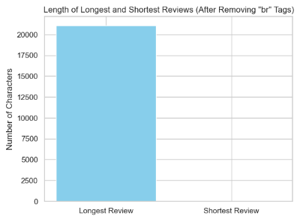
Length of longest and shortest reviews (after cleaning)

Slide 19
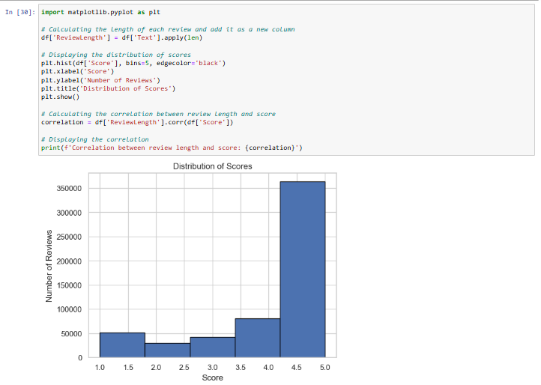

Distribution of Scores and correlation between review length and score

Slide 20
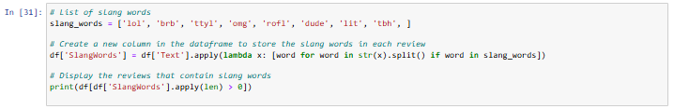
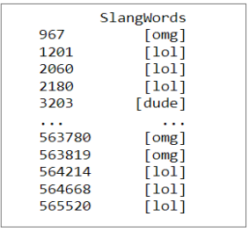

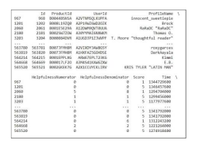
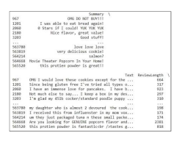
SlagnWords , their bigram and their use in dataset

Slide 21
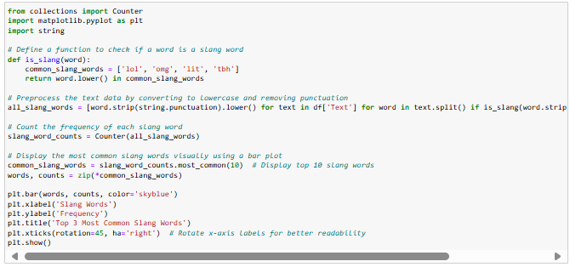
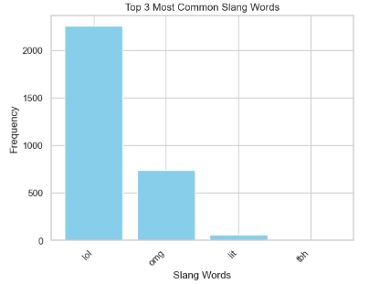
Plot representation of top 3 most used Slang Words

Slide 22
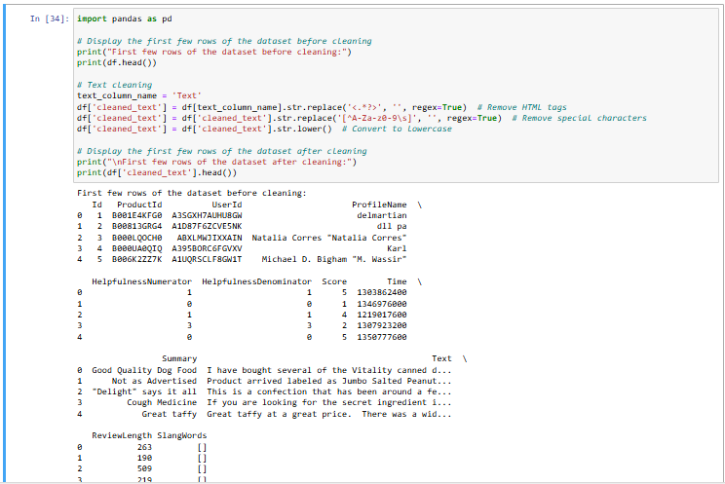
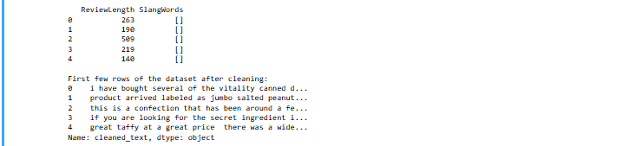
Performing text cleaning

Slide 23
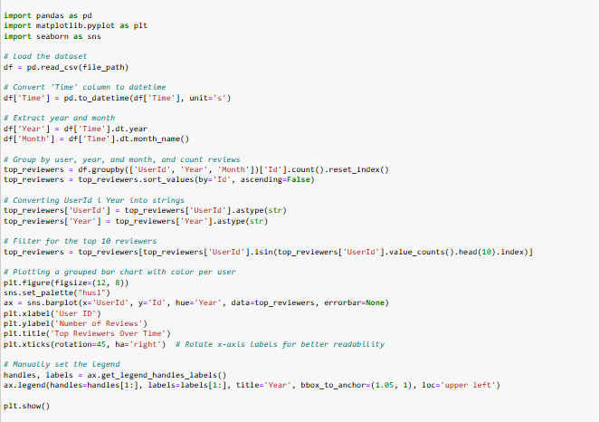
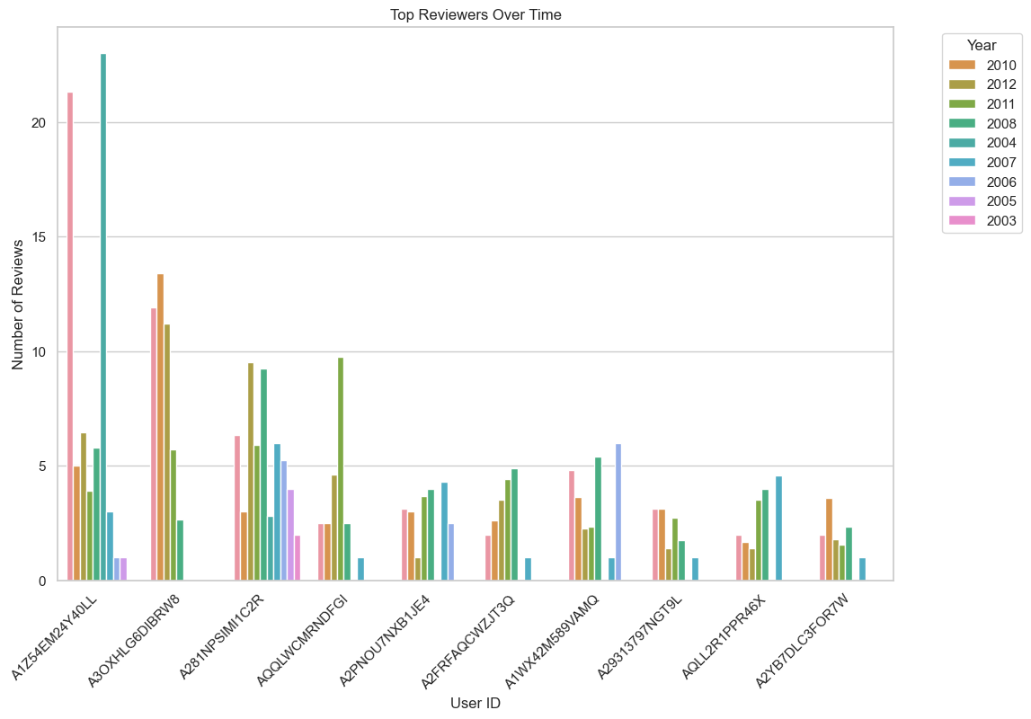
Top reviewers over time

Slide 24
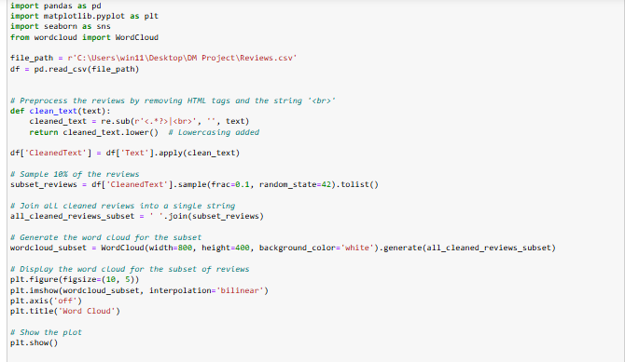
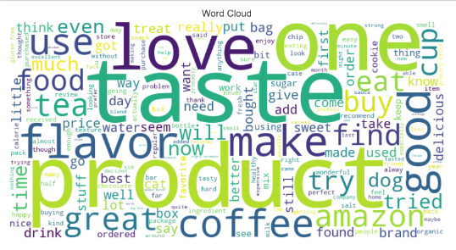
Creating Word Cloud of subset

Slide 25
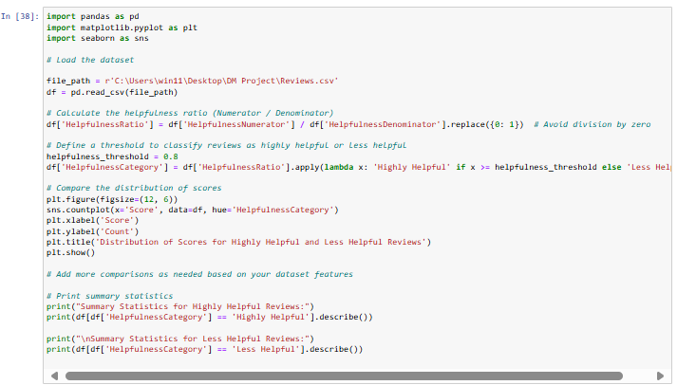
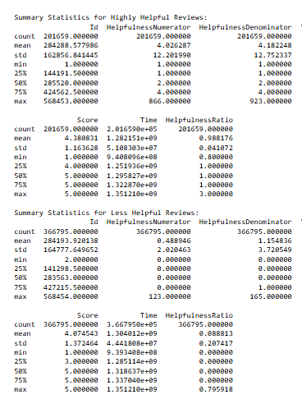

Distribution of Scores for Highly Helpful and Less Helpful Reviews

Slide 26

Machine Learning and Data Analysis

Slide 27

Decision Tree Classifier (DTC)

Slide 28

Naive Bayes Theorem

Slide 29


Linear Regression

Slide 30

Mean square error and R*2 score

Slide 31

kNN

Slide 32


Logistic Regression

Slide 33

CLUSTERING :
KMeans

Slide 34

KMedoids

Slide 35

BIRCH

Slide 36

The DBSCAN (Density-Based Spatial Clustering of Applications with Noise)

Slide 37


AdaBoost and Random Forest
Random Forest Algorithm
AdaBoost Algorithm

Slide 38
QUESTIONS?
For further questions :
eman.hrustemovic@stu.ibu.edu.ba

